Slide 1
Hurricane Harvey – Track Analysis
Data Analytics & Visualization 2020

Slide 2
Project Information
Project Team (Group 6):
Reza Abasaltian, Vincent Adams, Jeremy Jones, & Rob Pascarella
Project Scope:
As a group we have decided to gather data from offshore weather stations and platforms to perform an analysis of weather attributes as they correlate to the intensity of Hurricane Harvey.
Weather attributes analyzed:
Wind Speed (m/s); as our measure of intensity
Water Salinity (PSU – practical salinity unit [g of salt in kg of seawater)
Air Pressure (mBar)
Water Temperature (°C)
Air Temperature (°C)

Slide 3
Questions
What weather attributes contributed the most, if any, to the intensity of Hurricane Harvey?
Did water temperature affect intensity of the hurricane the most?
Did air temperature affect the intensity of the hurricane the most?
Did air pressure affect the intensity of the hurricane the most?
Did water salinity affect the intensity of the hurricane the most?
How will this problem be attacked?
Graphically, we will represent our data in scatter plots to show correlations as well as box plots to show our outliers in within each data set.
Statistically speaking, correlation coefficient and p-value will be used to assess each attributes relativity to wind speed, our standard for hurricane intensity.
Notably, as the project grew, several more data sources were found that would provide very interesting insight,

Slide 4
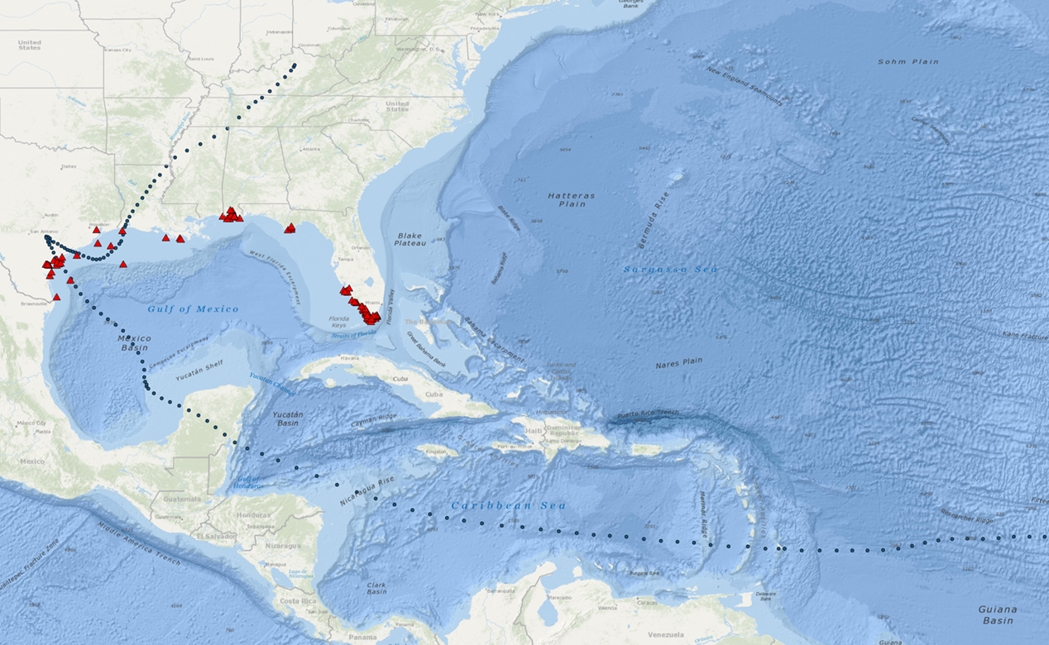
Project Data Sources
Data Retrieval
.csv data:
Gulf of Mexico Coastal Ocean Observing System
http://data.gcoos.org/waf.php
National Hurricane Center
https://www.nhc.noaa.gov/data/tcr/AL092017_Harvey.pdf
-Utilized data, created a csv for Harvey track
API:
GMaps
https://cloud.google.com/maps-platform/
Hurricane Harvey was extremely destructive in terms of water …

Slide 5
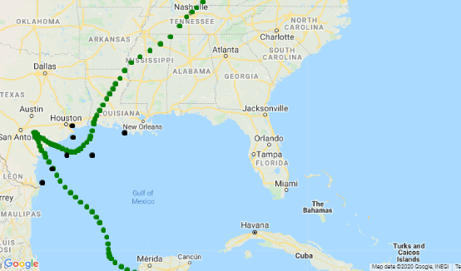
Project Data Point Locations
Selected Data Points:
A = 42043
B = 42044
C = 42047
D = 8764314
E = 8770613
F = TABS-X
G = 42019
E
A
D
G
C
F
B

Slide 6
Data Cleanup
The GSOOS site referenced previously was scanned for availability of .csv data. The Harvey path was cross-referenced for general location. The seven locations shown contained the most complete data sets in regard to attributes that could be studied:
Wind speed was considered dependent variable.
Salinity, air temp, water temp, air pressure were independent attributes to be studied.
Reza’s cleaner worked here….
Stuff and things
Adding
s

Slide 7
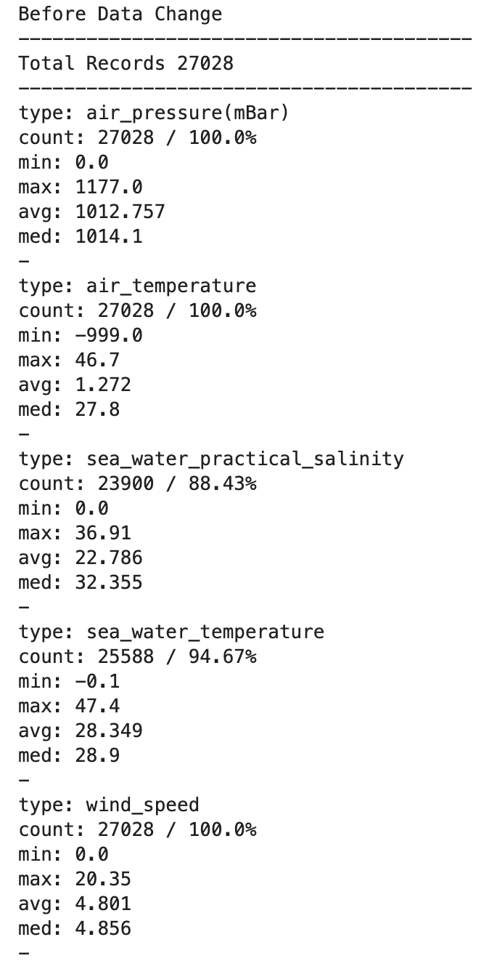
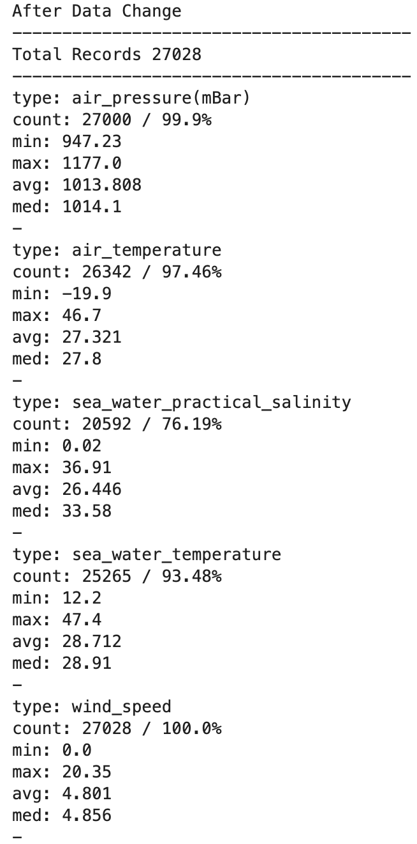
Data Cleanup, Cont.
All .csv files were combined using an outside join technique, keying on the date/time collected.
The data was examined for continuity:
It was noticed that there were several gaps that were solved by nulling these areas.
After the data was scrubbed, it can be shown that a large portion of the data was salvaged for utilization in harvesting analysis plots, tables, and tests.

Slide 8
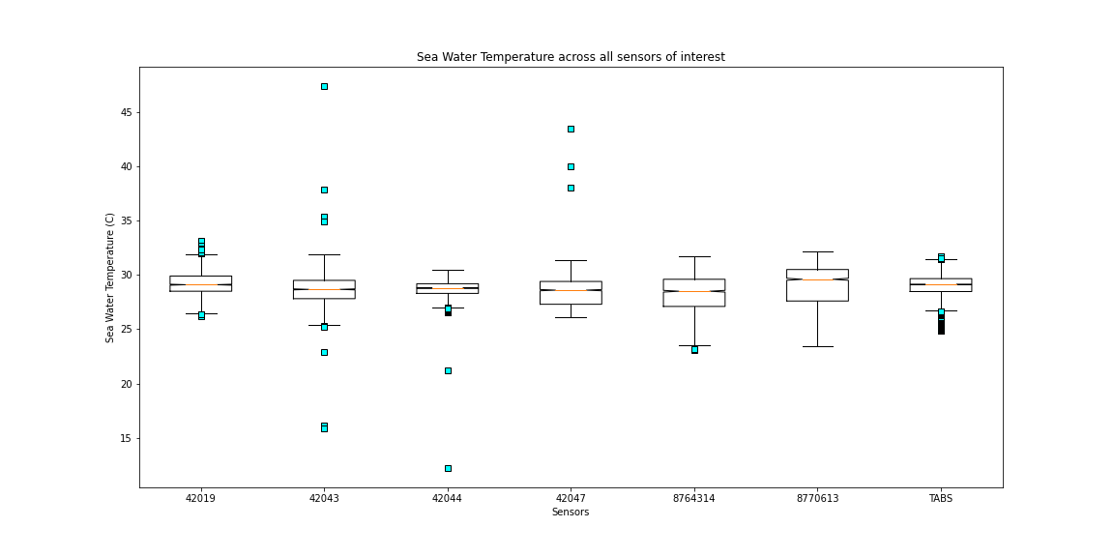
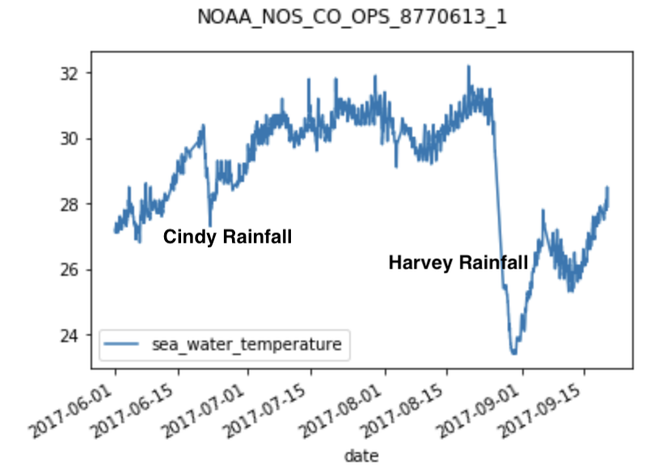
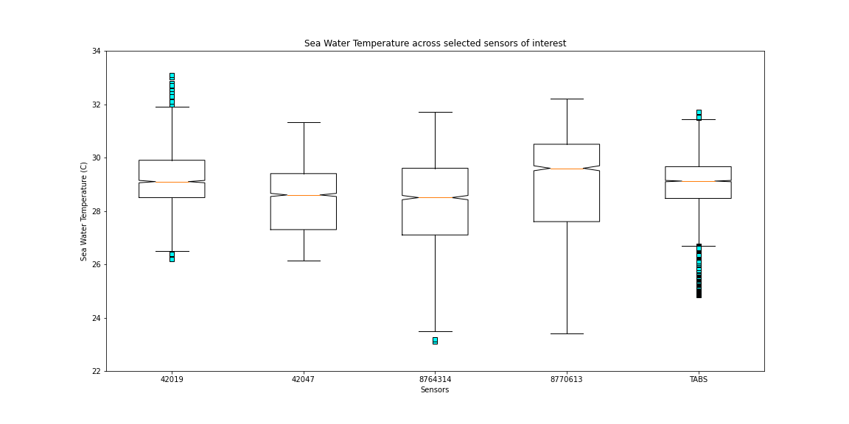
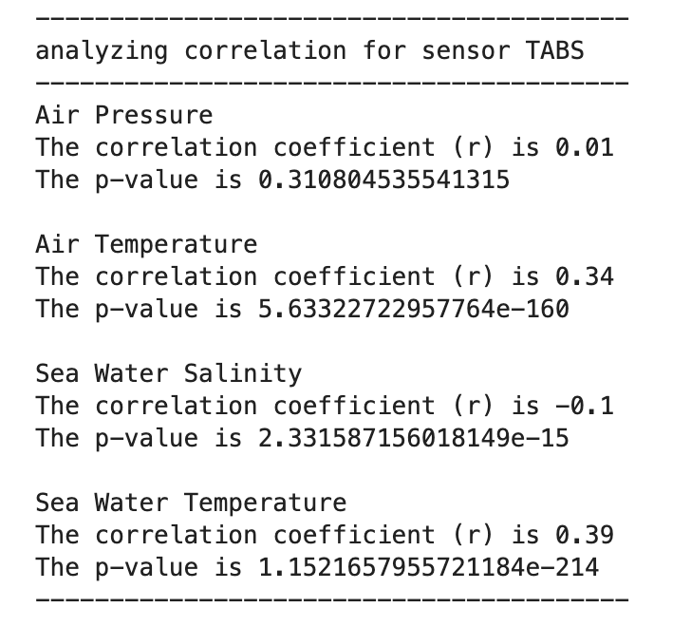
Water Temperature
Data Outliers
Water temperature was found to be the 2nd highest relative correlative with strength.

Slide 9
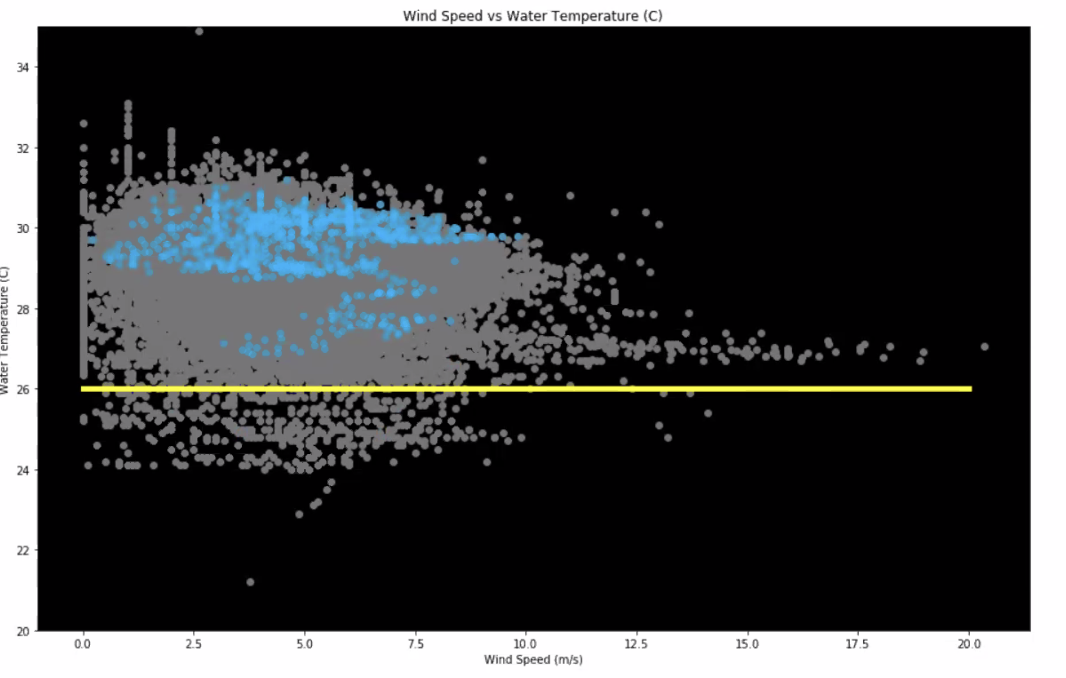
Water Temperature Firefly
The grey data here shows the population of water temperatures recorded over the entire summer. The blue dates highlight the timeframe that was recorded in the several days leading up to Harvey landfall.
The yellow line was installed for reference.
Through independent research, it has been noted that the strongest storms typically occur with water temps over 26°C – note that all of this data is above the “go/ no-go” line.

Slide 10
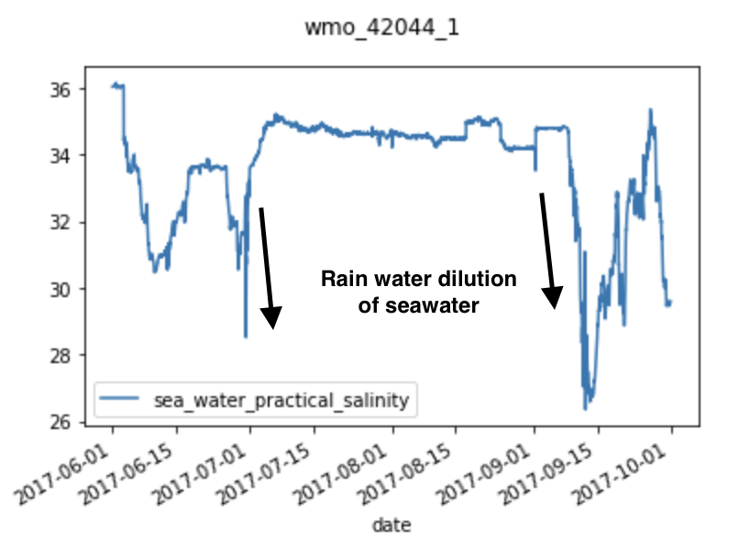
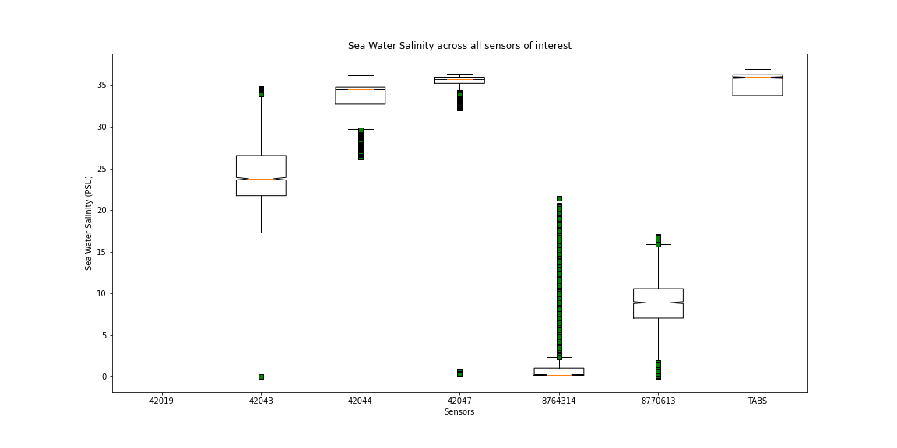
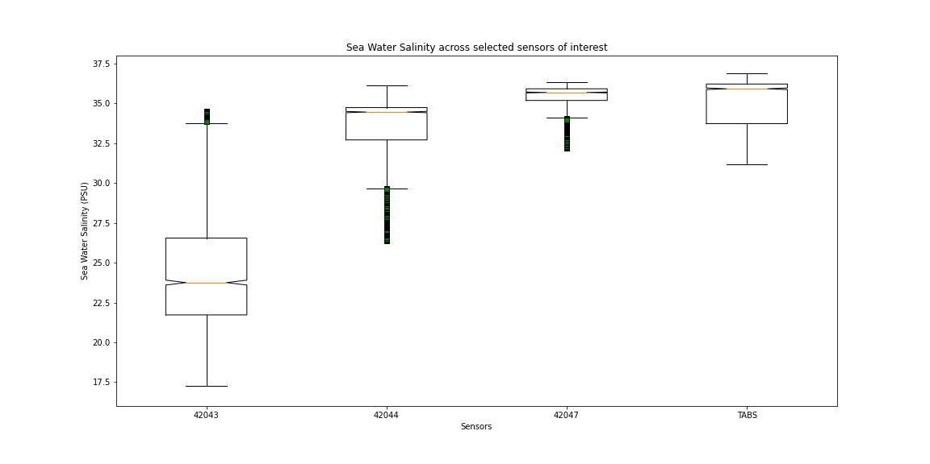
Water Salinity
Data Outliers
Salinity data piqued our interest early in the project. However, as research continued, we found it difficult to find quality data – much was sporadic / incomplete. This fact alone made quality analysis difficult for this attribute.

Slide 11
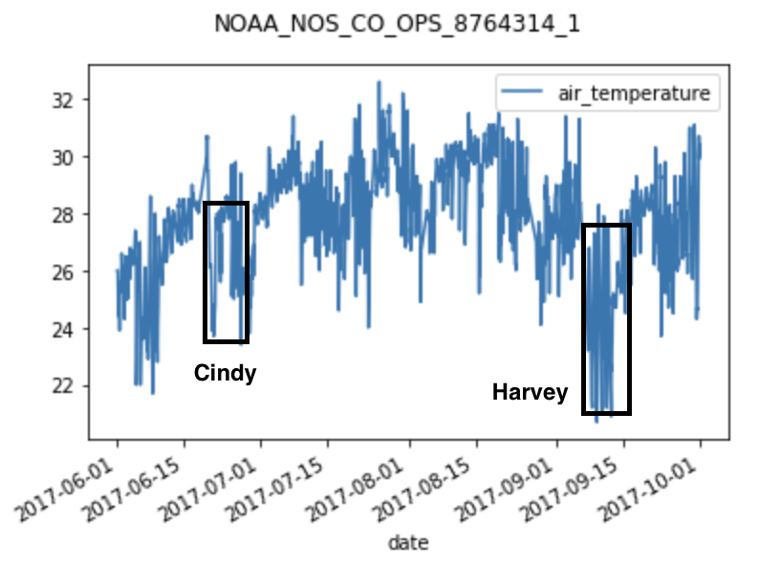
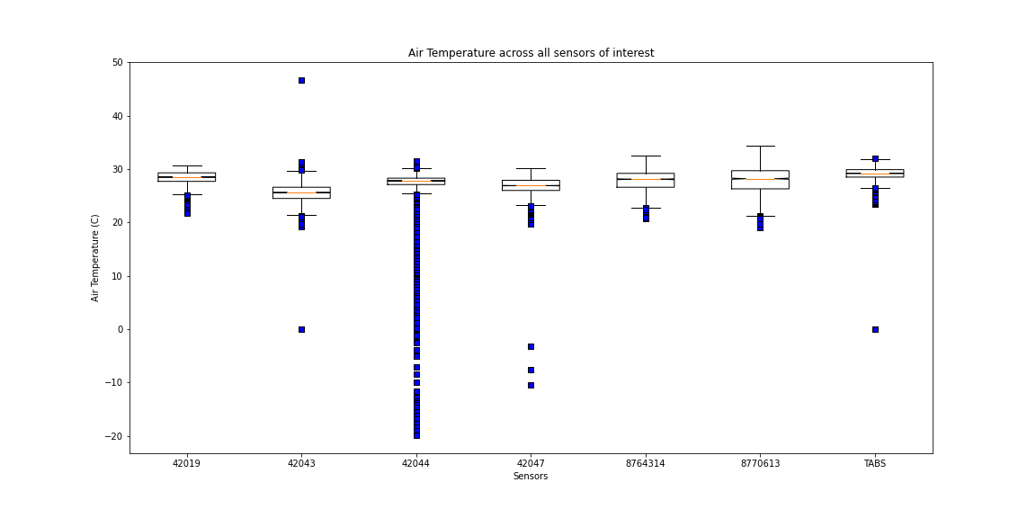
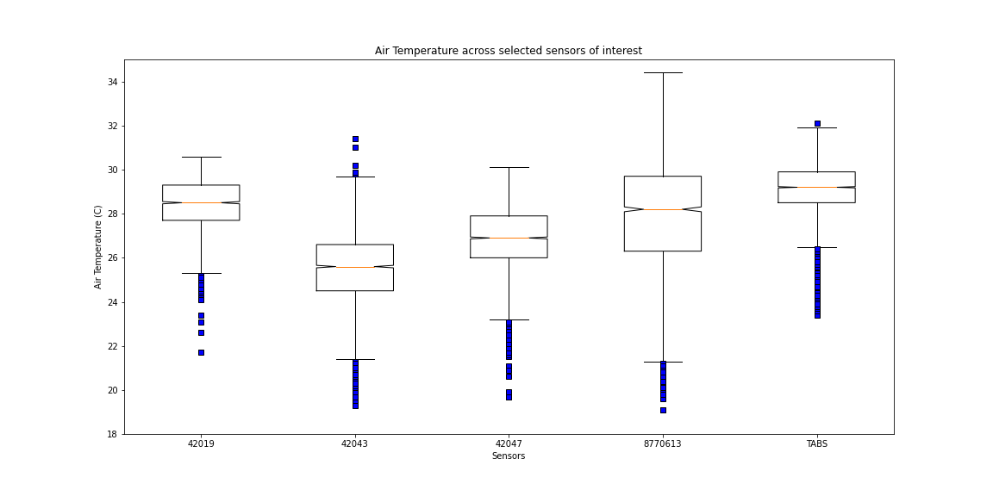
Air Temperature
Data Outliers
Something here

Slide 12
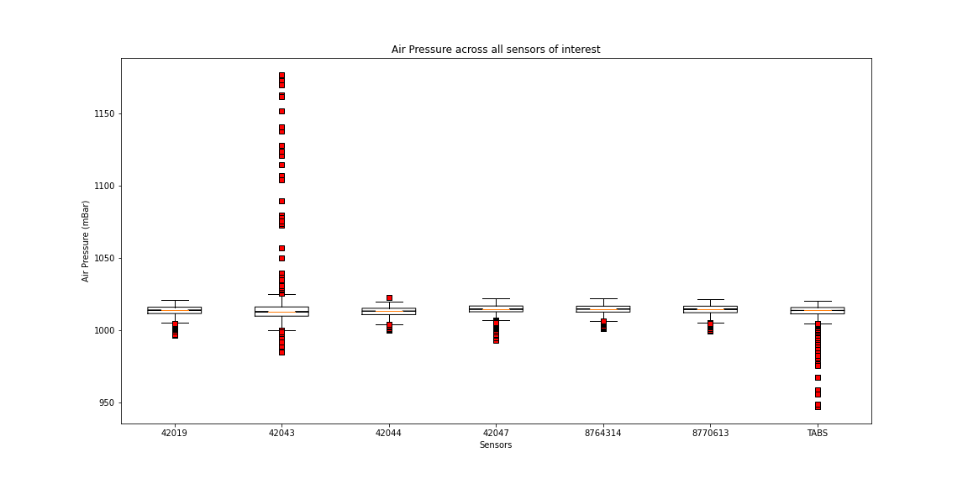
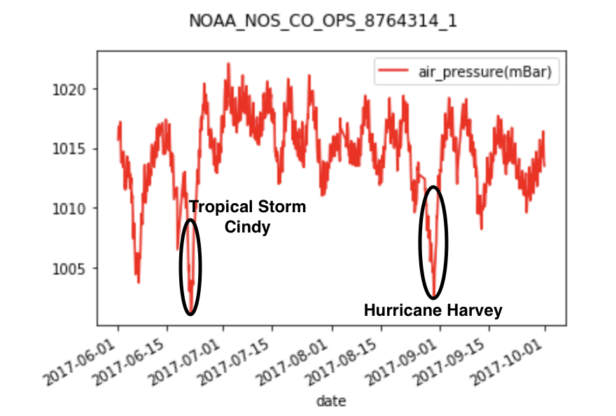
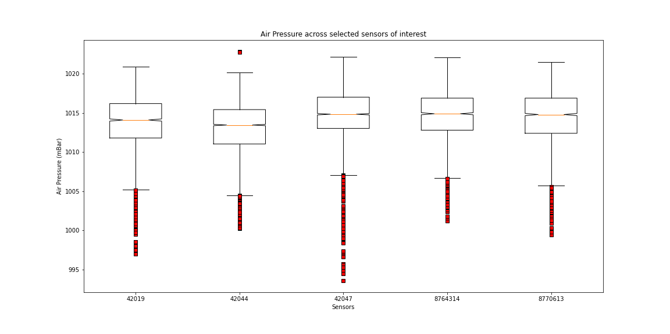
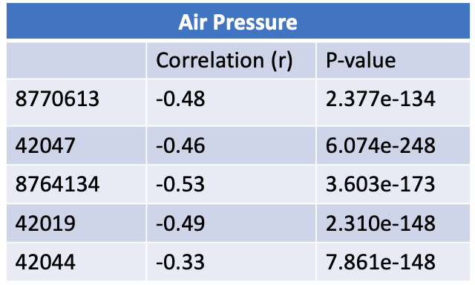
Air Pressure
Data Outliers

Slide 13
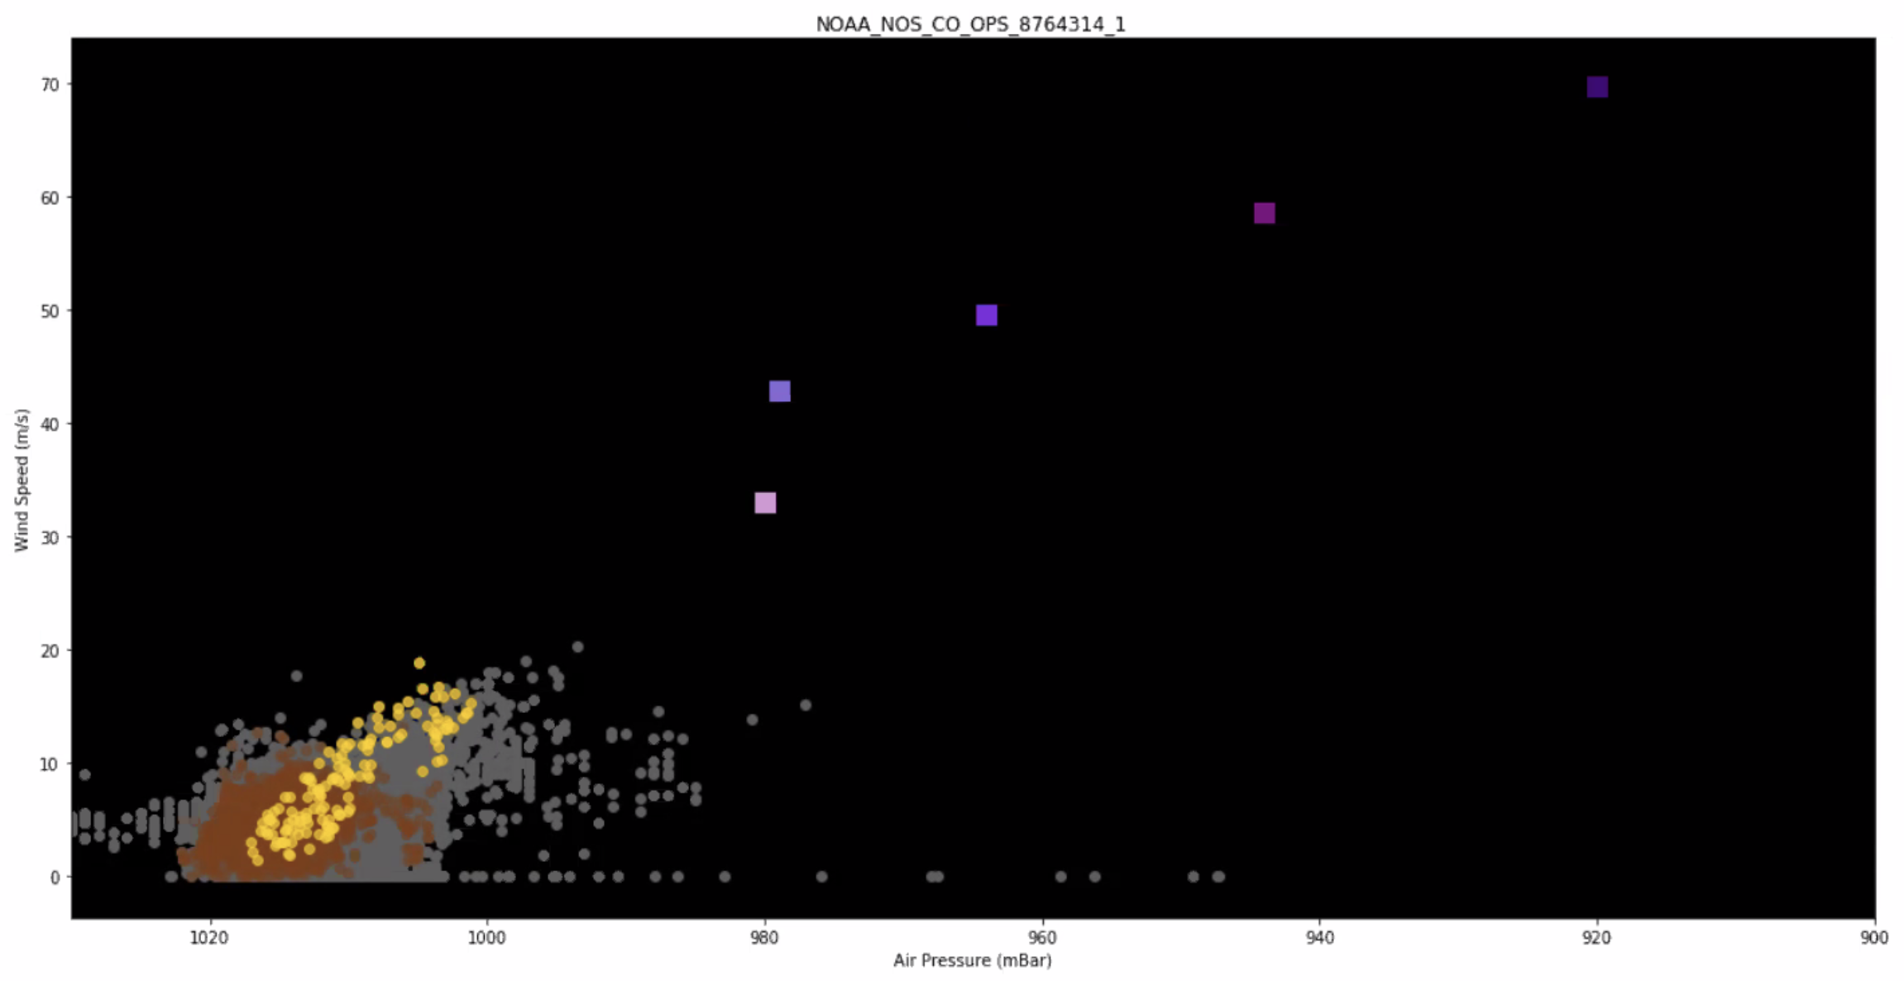
Air Temperature Firefly
Some explanation here noting ……..
blah

Slide 14
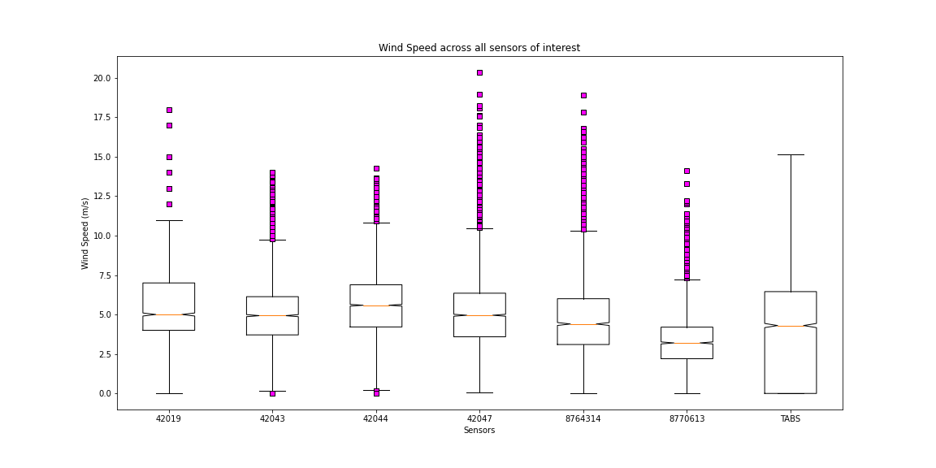
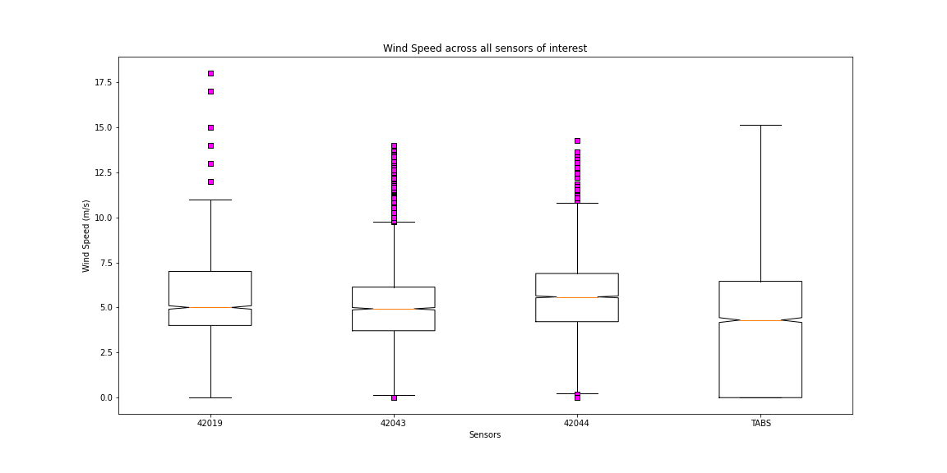
Wind Speed
Data Outliers
In the case of wind speed, we do NOT want to ignore outliers. The outliers (higher wind speed) as they would relate to the remaining data would in fact be the hurricane strength speeds.

Slide 15
Limitations
As is typical for a data project, the group was at the mercy of the available data. Only certain platforms/weather stations acquired the point useful for analysis that lie in a vicinity of the path of the storm.
Even as useable sites were located, as the project progressed, it was found that there were several levels of incompleteness regarding the gathered data sets. For example:
Inconsistency of sensor data acquisition by location and time.
Sensor calibration.
Missing data.
Erroneous data on some the data sets during the actual Hurricane.
Several instances of incomplete data during the storm.
X,Y,Z data was particularly incomplete.

Slide 16
Conclusions
Notes notes notes about how our p-test showed highest correlation of wind speed to air pressure. Not only did the tests have

Slide 17
Continued Analysis

Slide 18

Questions
Thank you for your time and attention!
Questions, please!?

